Slide 1
Topic: Multiplication with arrays EQ: How do you apply the array strategy?
Year 11 Essentials

Slide 2
Things Required For This Lesson
Interactive Notebook
Textbook: Interleaved Maths Essential Connections
Ruler, Red Pen, Pencil, Pens, Scientific Calculator
Growth mindset

Slide 3

24
7
30
Topic: Multiplication with arrays
Date:
EQ: How do you apply the array strategy?
WICOR
This Photo by Unknown Author is licensed under CC BY-SA

Slide 4
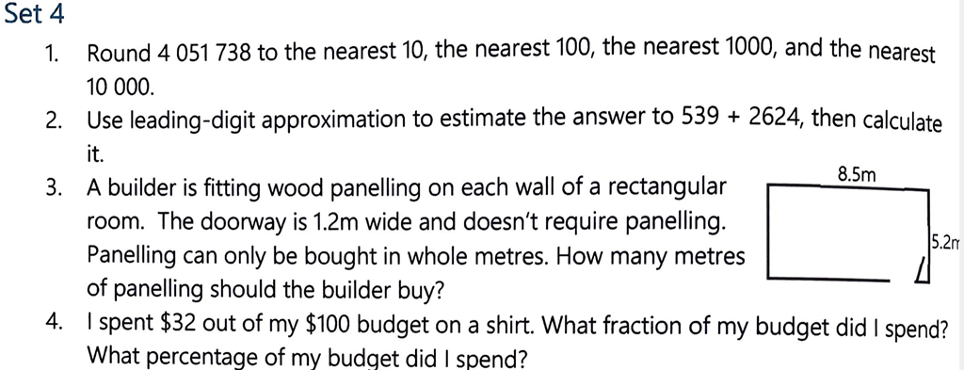
Topic: Division with array EQ: How do I apply the division with array strategy?
Interleaved Questions: Set 4 page 134

Slide 5
24
7
30
Topic: Multiplication with arrays
EQ: How do you apply the array strategy?
What is an array?
A set of objects or numbers arranged in order, often in rows and columns.
What does product mean?
The result when two numbers are multiplied.
WICOR

Slide 6

24
7
30
Topic: Multiplication with arrays
EQ: How do you apply the array strategy?
What is an multiplication array?
Factors are the rows and columns, multiple is the area
WICOR

Slide 7
Examples of arrays:
This array has 4 rows and 3 columns. It can also be described as a 4 by 3 array. The equation could represented as: 4 × 3.
This array has 5 rows and 4 columns. It is a 5 by 4 array. The equation would be represented as

Slide 8
Experiment (LHS)
Count each of the rectangles below to determine how many squares make up the area

Slide 9
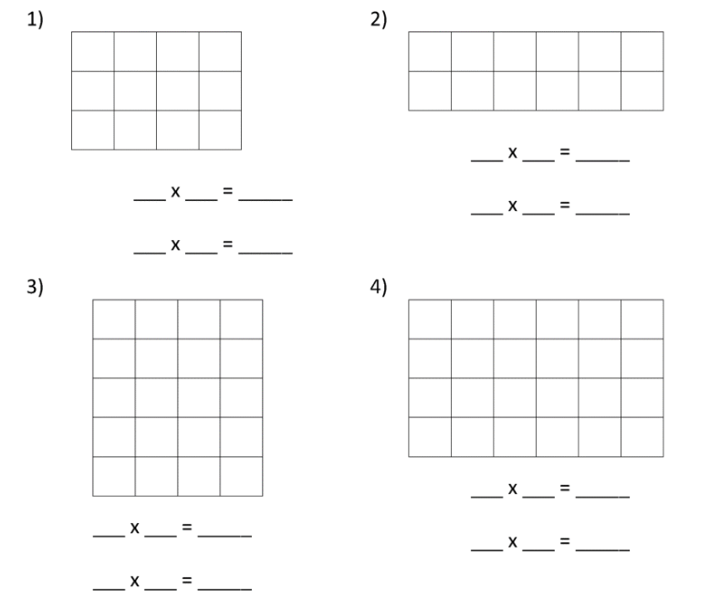
Practice (LHS)
Look at these arrays and change them into multiplication sentences.

Slide 10
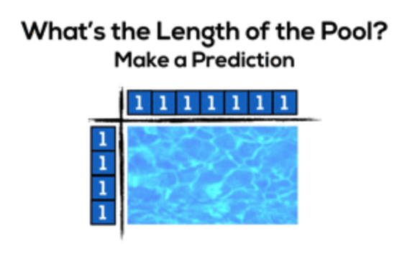
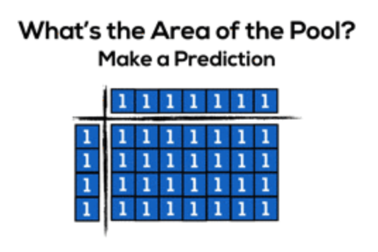
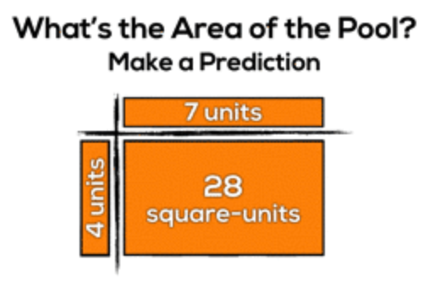
To avoid having to count every square, the array model of multiplication uses the number of rows and number of columns in an array to illustrate the product of two numbers.
The product of an array can be multiplied by counting the rows and columns

Slide 11
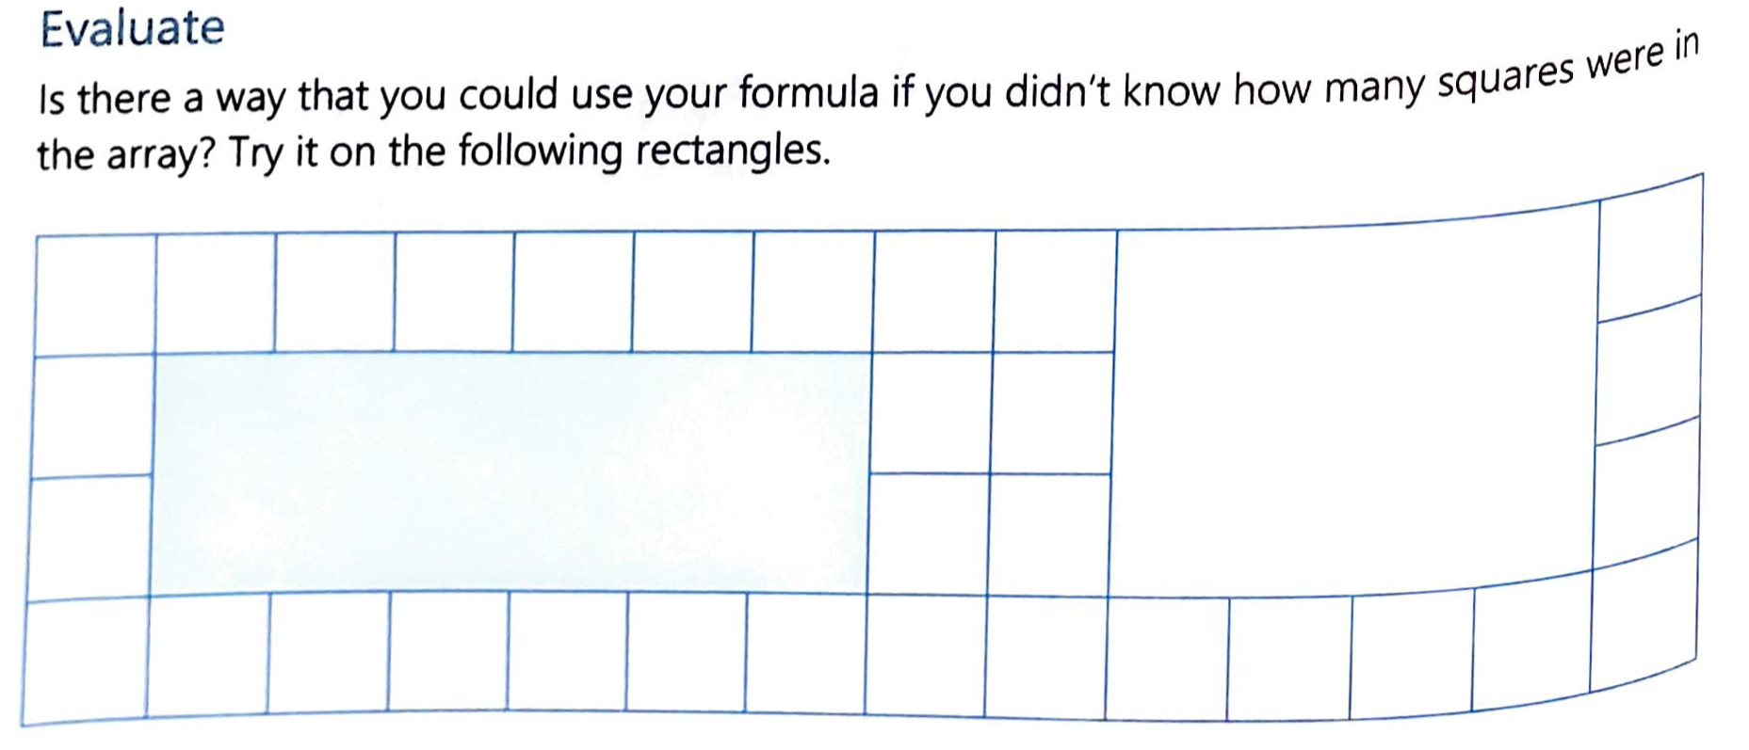

Slide 12

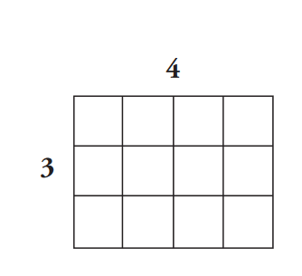
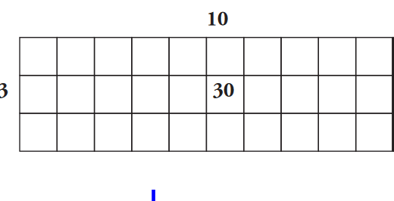
Find the area of these arrays:

Slide 13
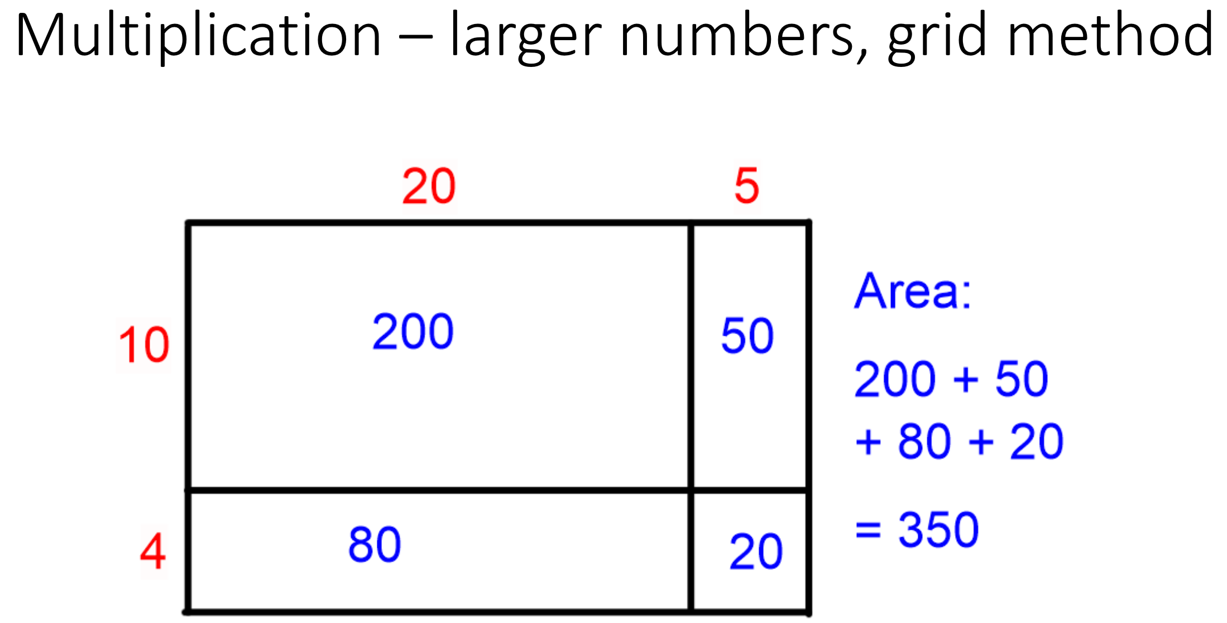
Fun Fact – used to solve large multiplication

Slide 14
Practice (LHS)- Solve this without counting all the squares

Slide 15
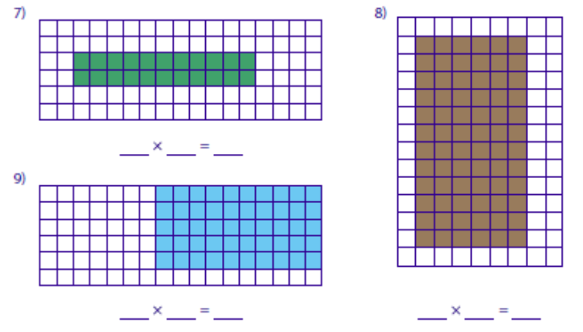
Practice (LHS) try and not count all the squares
Think about how you find the area of a rectangle:

Slide 16
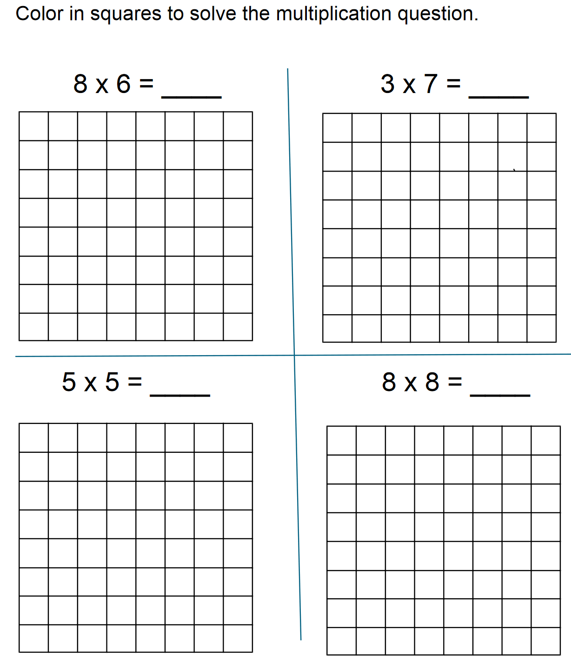
Practice
You will need grid paper:

Slide 17
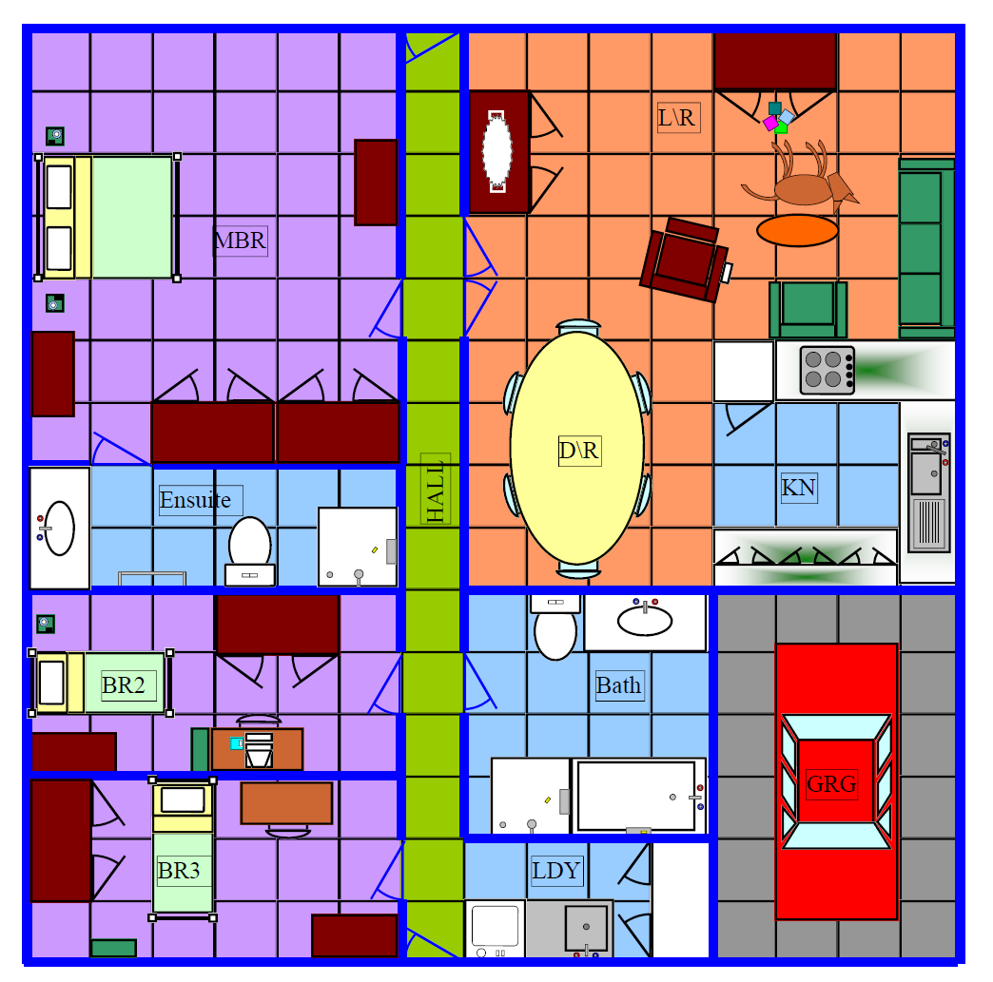
Find the area of each room
MBR:
Ensuite:
BR2:
BR3:
Hall:
L/R:
D/R”
KN:
Bath:
LDY:
GRG:

Slide 18

explain
Explain how you would use your formula and your ideas so far to calculate the area of the following rectangle:
Your desk in ${cm}^{2}$
Your classroom floor in $m^{2}$
A rectangle that was twice as long as it was high. The height was 5cm
Do the rest of the questions on page 23 of your Interleaved Math Book
Notes:
Have post-it notes pre-prepared with -50, 25, 0, -75, 50, 75 for whole class display on the board

Slide 19
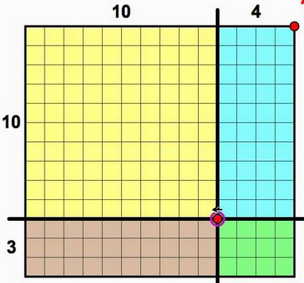
Exit Ticket
Write a multiplication sentence and find the area of each section
Yellow:
Blue:
Brown:
Green:
What is the combined area? Write a multiplication sentence

Slide 20

Thank you
Keep up the good work!
“The very things that hold you down are going to lift you up.”

